Slide 1
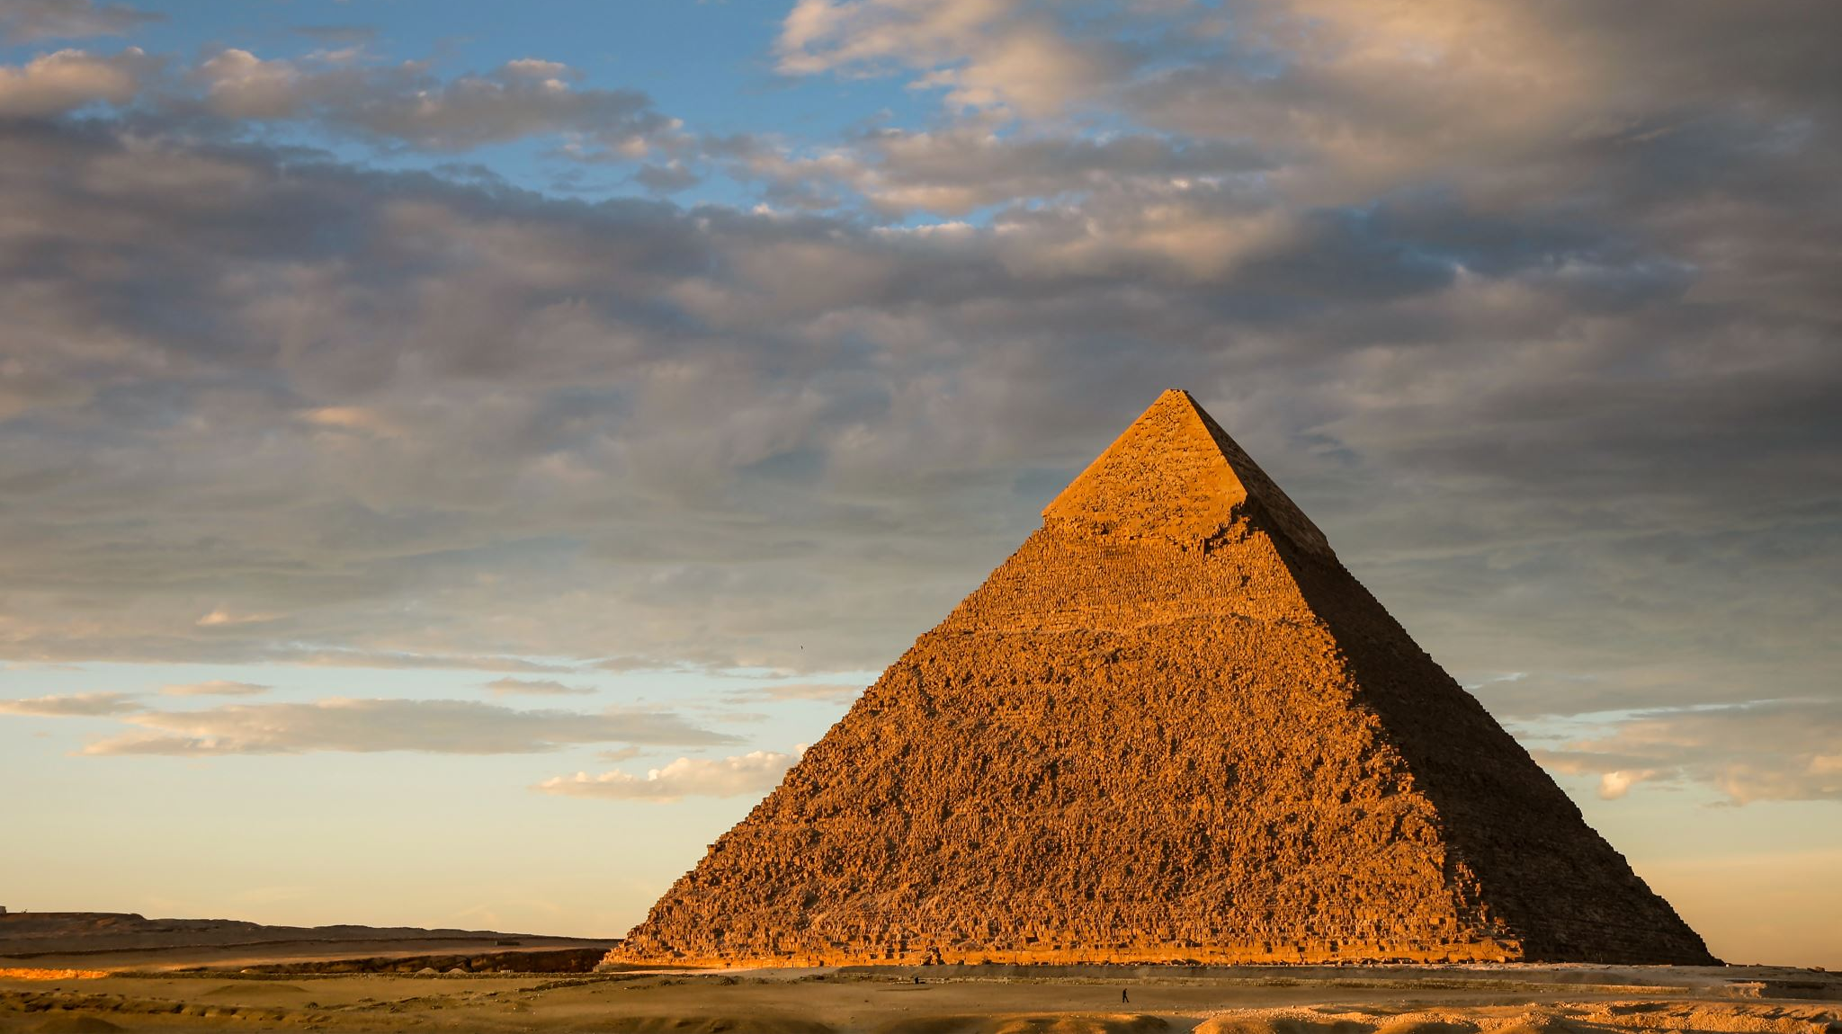
The lair of the Sphinx
Jake, Dean, Will, Travis and Max

Slide 2
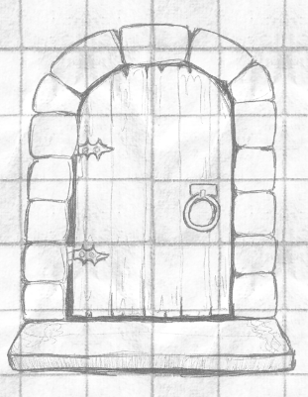
Enter the dungeon
Battle Monsters
Answer the Riddles
Level Up
Defeat the Sphinx

Slide 3
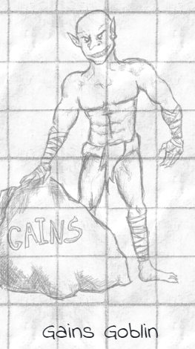
The Process

Slide 4
Technologies
HTML 5
CSS 3 and BootStrap
JavaScript
Node.js
Bcrypt
Connect Session Sequelize
Dotenv
Express
Express-Handlebars
Express-Session
MySQL2
Sequelize
NanoID
MySQL

Slide 5
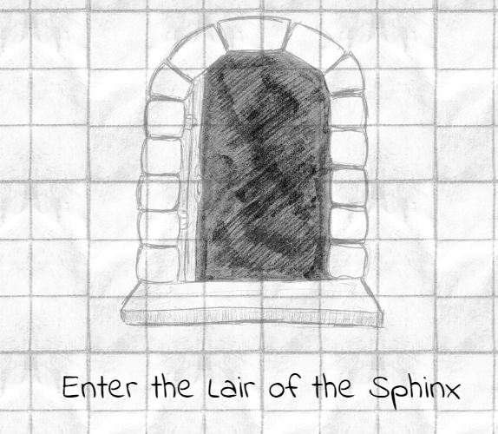
Demo

Slide 6
Team
Jake Schlei
Dean Dunivan
Will Bolls
Travis Geers
Max Lanfear

Slide 7
Conflicts/Additions
Conflicts
Wins
Future plans
Protecting all of our routes
Dividing the work
Multi-word answers
Coming up with more ideas than we had time for
Better at GitHub merges
Working together to overcome the work conflict
Came up with a project that we are all proud of
High Score page
Different levels of difficulty
Adding a store to purchase more health and giving coins for correct answers
Adding a message board

Slide 8
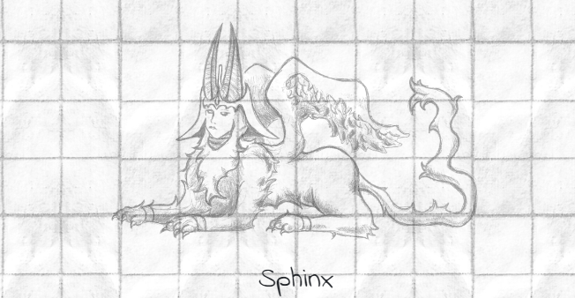
Thank you
Jake, Dean, Will, Travis and Max
https://github.com/Dodgemech/The-Lair-of-the-Sphinx
https://the-lair-of-the-sphinx.herokuapp.com/

